Slide 1

P and NP
Instructor: Kuan Cheng

Slide 2
Topics
Equivalence of two definitions of NP
A new kind of reduction
NP-completeness and Cook-Levin Theorem

Slide 3
Computation of a non-deterministic TM
Whenever the transition function has 2 possible outcomes
The TM splits into 2 copies/branches, with each copy taking one outcome.
The TM accepts an input if ∃ a branch that accepts the input.
The TM rejects an input if all branches reject the input.

Slide 4
Running time of a non-deterministic TM
Similar to TM, an NDTM may not halt on an input for some branch of computation.
We prefer NDTMs that halt on all branches of computation (decider).
For a function T: N →N, say an NDTM N runs in time T(n) if for any input of length n, all branches of N halt within T(n) steps.

Slide 5
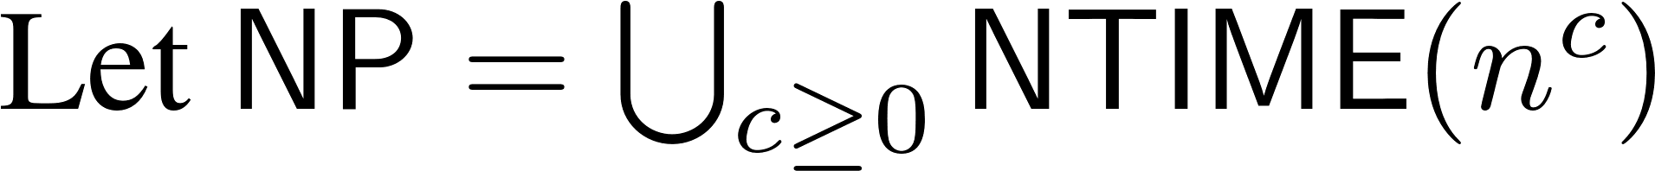
NTIME and alternative definition of NP
Let T: N →N be some function. Let NTIME(T(n)) be the set of all languages that can be decided by some NDTM in time O(T(n)).
i.e., all languages decidable by some NDTM in polynomial time of the input length.

Slide 6
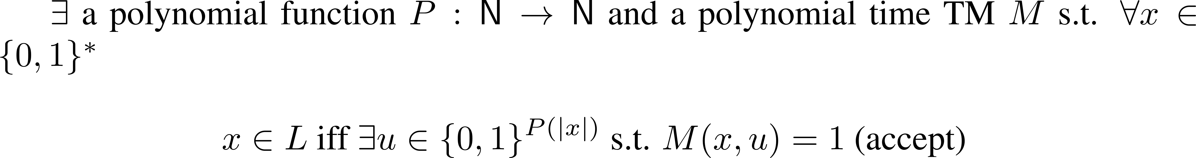
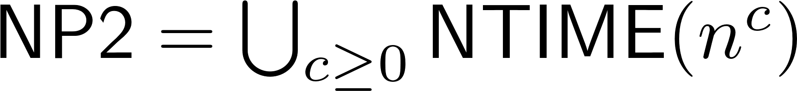
Equivalence of two definitions of NP
Recall:
Def1: A language is in NP1 if
Def2:
Show that NP1 = NP2

Slide 7
Proof part 1

Slide 8
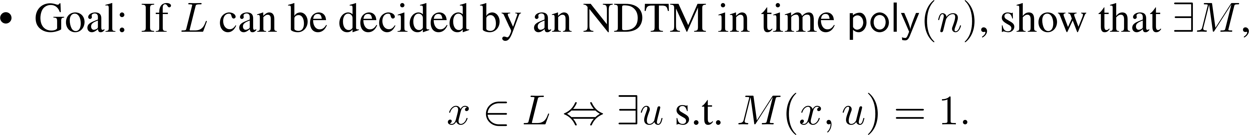
Proof part 2

Slide 9



From Previous Lecture
P ⊆ NP ⊆ EXP
At least one is proper
P vs. NP is one of the unsolved millennium problems

Slide 10
P vs. NP
To prove P=NP: show all languages in NP can be decided in polynomial time
To prove P≠NP: show one language in NP that cannot be decided in polynomial time
Unify: for both cases only need to study one specific language, i.e., the hardest language in NP

Slide 11
The Hardest language in NP
How to define hardest?
Use reduction: if A ≤m B then B is “harder” than A.
A language is hardest if all other languages in this class can be reduced to it.
Need to use a modified reduction related to the classes.

Slide 12
The Reduction
When studying two complexity classes, the reduction should not be more powerful than the weaker class
When studying one complexity class, the reduction should be weaker than the algorithms in the class
P vs. NP: polynomial time reduction.

Slide 13



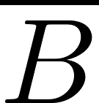
Recall Mapping Reduction

Slide 14
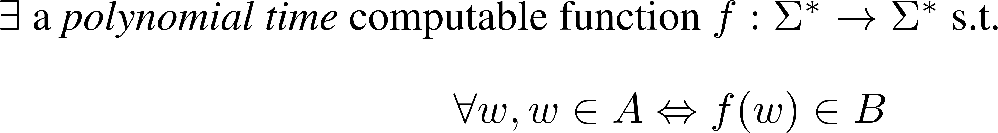
Polynomial Time Reduction
Notes:
Function calling picture of P43 Arora

Slide 15
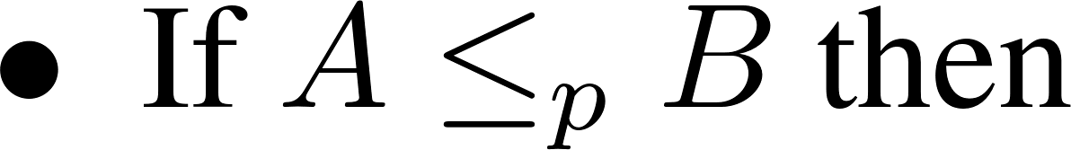
Properties of poly-time reduction

Slide 16
NP-hard and NP-complete
A language L is NP-hard if ∀ A ∈ NP, A ≤p L (L is harder than all languages in NP).
A language L is NP-complete if L is NP-hard and L ∈ NP (L is the hardest language in NP).
If L is NP-hard and L ∈ P, then P=NP.
If L is NP-complete, then L ∈ P iff P=NP

Slide 17
Implications
If L is NP-complete, then L ∈ P iff P=NP.
The P vs. NP question boils down to study one language (an NP-complete language).
But, does such a language exist?
Notes:
Arora P43 Theorem 2.9

Slide 18
Cook-Levin Theorem (1971)
The first NP-complete language.
Soon after, Karp showed many other NP-complete languages.
Boolean formulas and SAT.

Slide 19
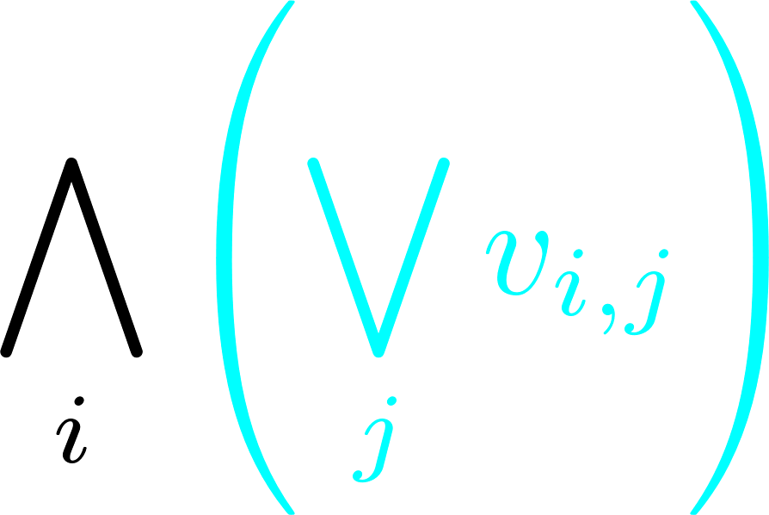
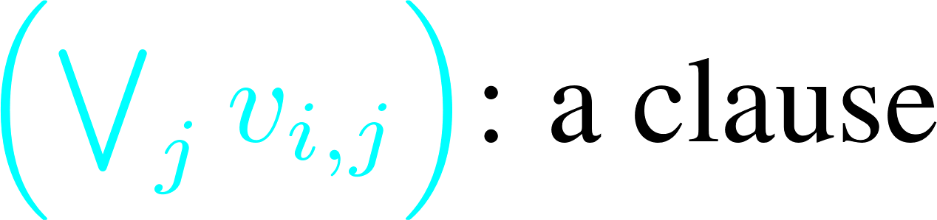
Boolean formulas circuits CNF SAT

Slide 20
Cook-Levin Theorem (1971)
Define SAT={all satisfiable CNF formulas}.
Define 3SAT={all satisfiable 3CNF formulas}.
Cook-Levin Theorem: SAT is NP-complete, 3SAT is NP-complete.
Notes:
Definition of Boolean formulas, CNF, SAT: Arora P44

Slide 21
Proof of Cook-Levin Theorem
SAT is NP-complete
Need to show:
SAT ∈ NP
∀ L ∈ NP, L ≤p SAT

Slide 22
SAT is NP-complete
SAT ∈ NP:
Certificate: a specific satisfying assignment.
∀ L ∈ NP, L ≤p SAT
Can only use the definition of NP

Slide 23
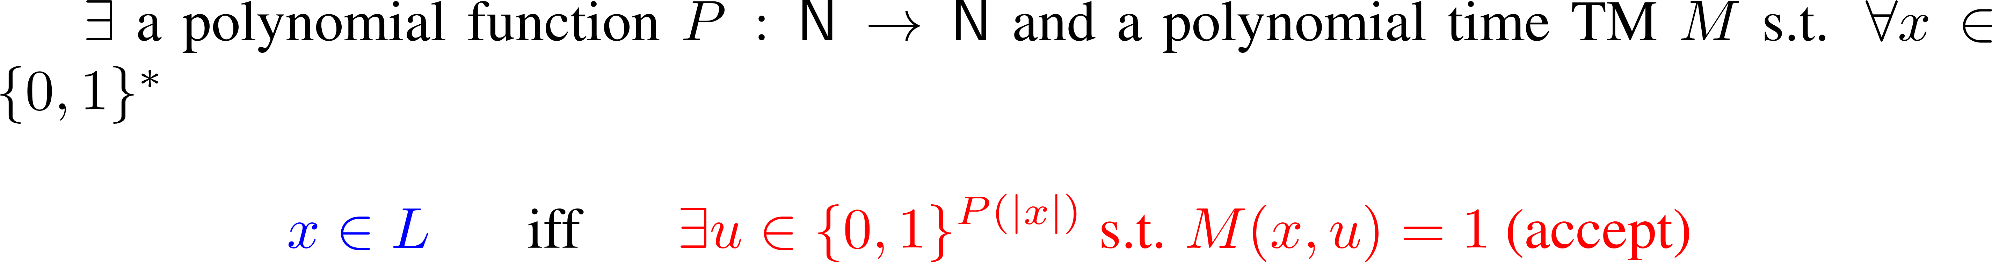
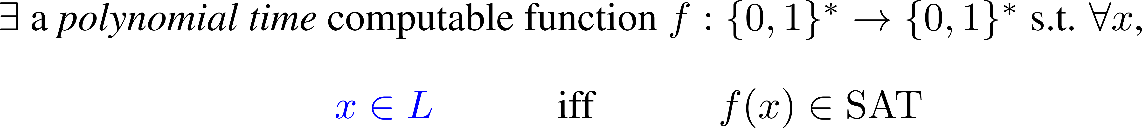
SAT is NP-complete
A language L is in the class NP if
∀ L ∈ NP, L ≤p SAT if

Slide 24
SAT is NP-complete
Give f s.t.
Idea: express the computation of M as a CNF formula ψ with polynomial size
Important idea: computation is local.

Slide 25
SAT is NP-complete

Slide 26
3SAT is NP-complete
3SAT ∈ NP
Show SAT ≤p 3SAT
Given any CNF formula ψ, construct in poly time another 3CNF ψ’ s.t. ψ ∈ SAT iff ψ’ ∈ 3SAT

Slide 27
Reduction from SAT to 3SAT

Slide 28
Reduction from SAT to 3SAT

Slide 29
Reduction from SAT to 3SAT

Slide 30
Reduction from SAT to 3SAT

